Slide 1

Adapting to Climate Change by
Improving Extreme Weather Forecasts

Slide 2
Headlines :
1
Introduction
2
Problem Definition
3
Objective
4
Steps and process including in the project
5
Conclusion

Slide 3

1. INTRODUCTION
forecasting the Extreme weather events are sweeping the globe and range from heat waves, wildfires and drought to hurricanes, extreme rainfall and flooding is important. Because, These weather events have multiple impacts on agriculture, energy, transportation, as well as low resource communities and disaster planning in countries across the globe

Slide 4

2. Problem Definition:
The problem addressed in the provided code and project is centered around enhancing sub-seasonal weather forecasting. The goal is to improve predictions of temperature, a crucial factor in understanding and preparing for extreme weather events and climate patterns over longer timeframes.
3. Objective
The main objective of this project is to advance sub-seasonal weather forecasting The primary aim is to enhance the accuracy and extend the forecast horizon for temperature predictions. By leveraging diverse meteorological data and employing machine learning algorithms like CatBoost, Gradient Boosting .the project seeks to overcome the limitations of short-term forecasting models. Ultimately, this endeavor aims to provide more reliable predictions crucial for effective preparation and adaptation to extreme weather events and climate changes impacting various sectors and vulnerable communities globally

Slide 5
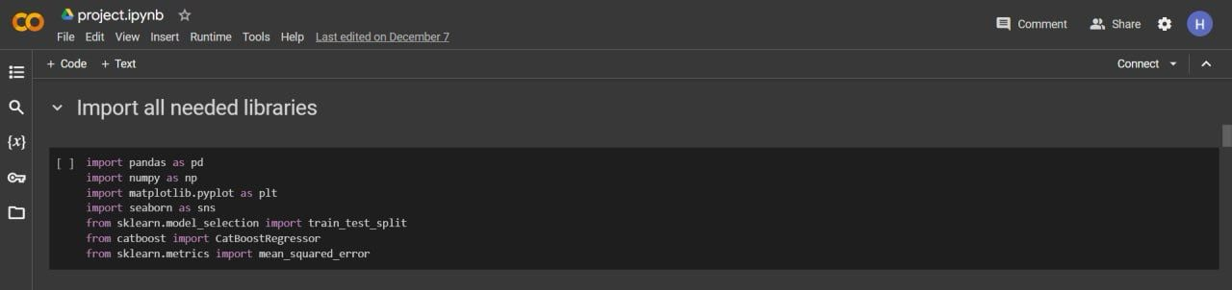
We started by import all needed libraries

Slide 6

Steps and processes including in the project
3.1 Data loading and exploration
The code starts by loading datasets containing a meteorological features necessary for weather prediction

Slide 7
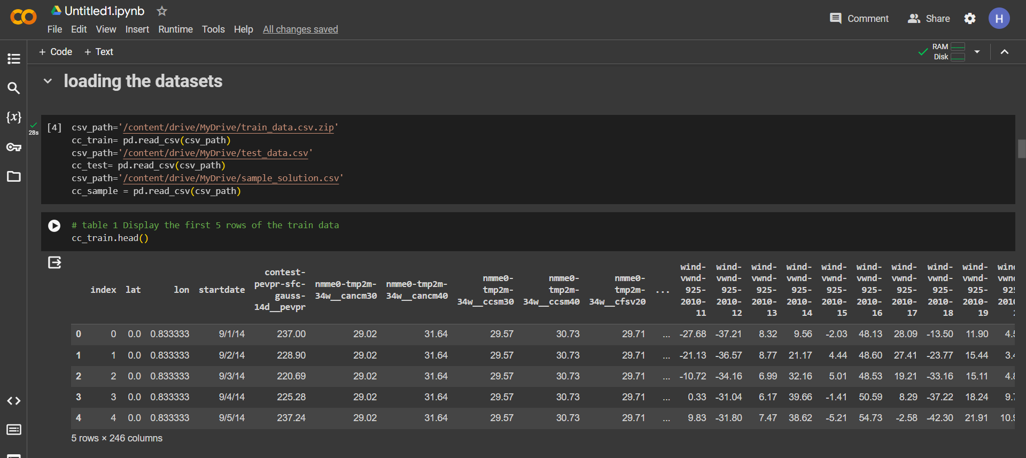
Steps and processes including in the project
The code snapshot showing bellow is used to load the dataset and displaying the first five rows, to give an overview about the dataset features.

Slide 8
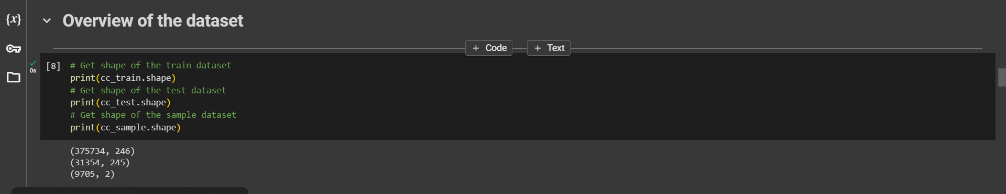
Steps and processes including in the project
The code snapshot showing bellow is showing the shape of the dataset by using the shape attribute we can investigate and know the number of columns and rows

Slide 9
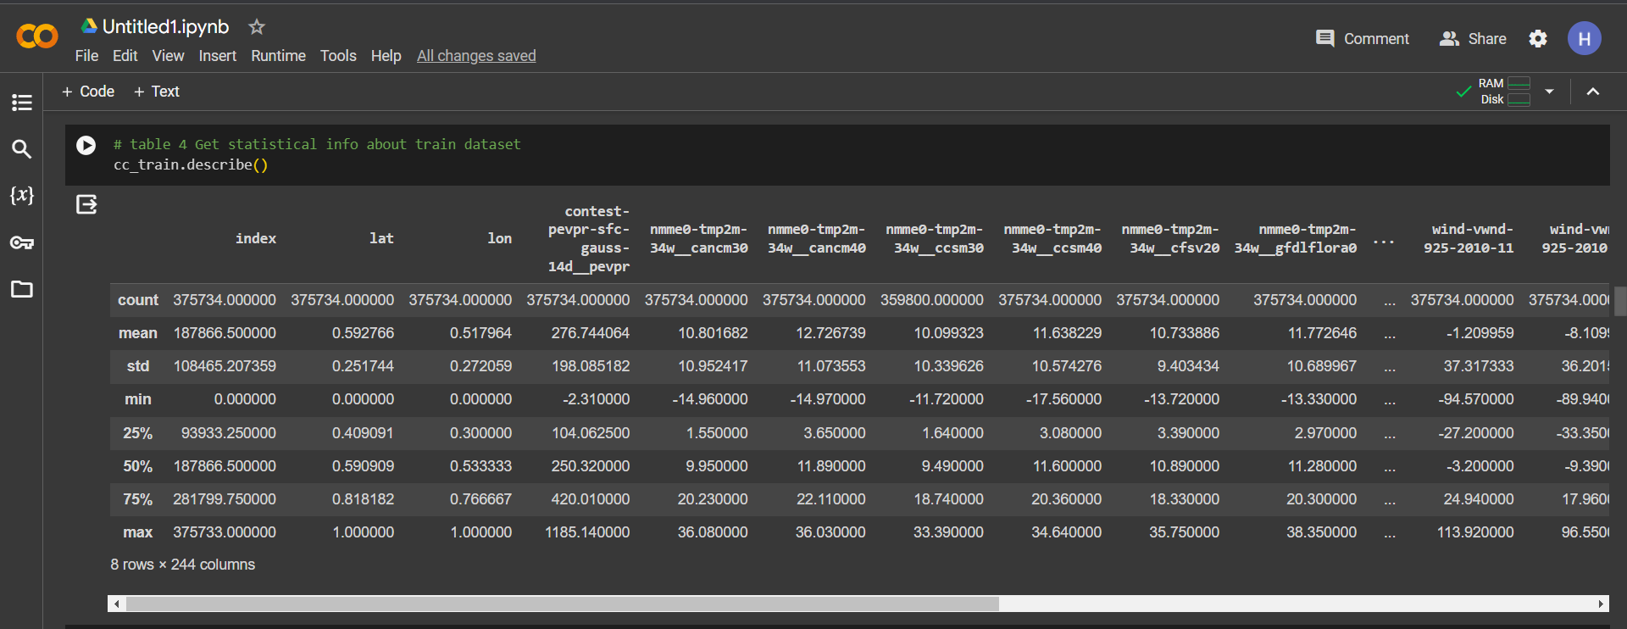
Steps and processes including in the project
As shown bellow and by using the describe method, we get some statistical information about the dataset such as the count, mean and standard deviation of each column beside that getting the max and the min value in each column.

Slide 10
Steps and processes including in the project
3.2 Data preprocessing
This involves handling missing values in the dataset. The code identifies and addresses null values, ensuring data cleanliness and readiness for modeling.

Slide 11
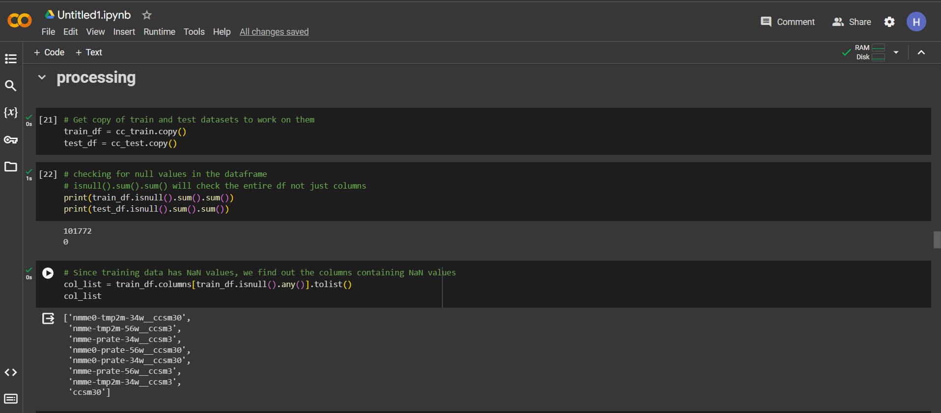
Steps and processes including in the project
The code bellow is proven that the dataset is clean and there is any null values, by using the is null method as shown above we able to know that the dataset is cleaned and ready for the next process.

Slide 12
Steps and processes including in the project
3.3 Visualization
visualizations play a crucial role in understanding the data and interpreting key insights. Here's Visualization of distribution of climatic regions:

Slide 13
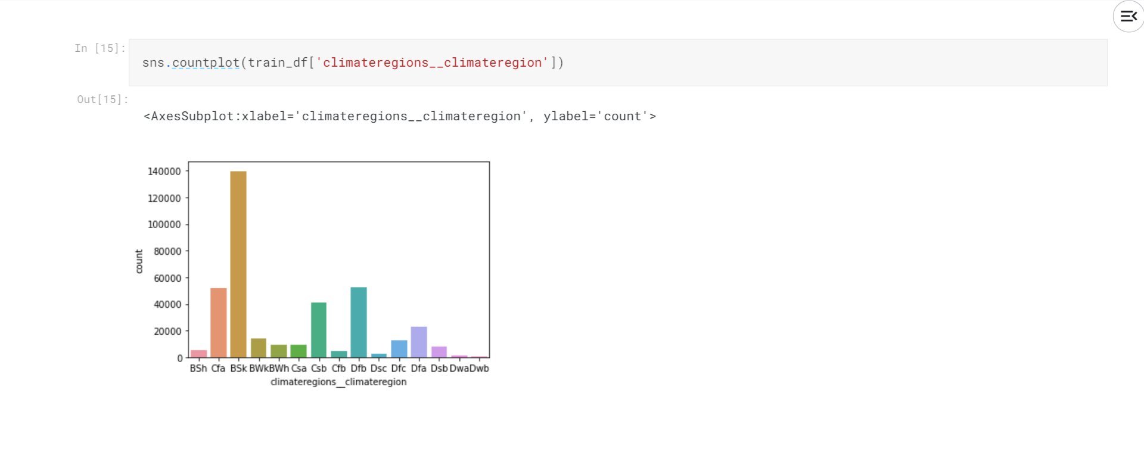
BSh:
Hot semi-arid climate
BSk:
Cold semi-arid climate
BWh:
Hot desert climate
BWk:
Cold desert climate
Cfa:
Humid subtropical climate
Cfb:
Temperate oceanic climate or subtropical highland climate
Csa:
Hot-summer Mediterranean climate
Csb:
Warm-summer Mediterranean climate
Dfa:
Hot-summer humid continental climate
Dfb:
Warm-summer humid continental climate

Slide 14
Dfc:
Subarctic climate
Dsb:
Mediterranean-influenced warm-summer humid continental climate
Dsc:
Mediterranean-influenced subarctic climate
Dwa:
Monsoon-influenced hot-summer humid continental climate
Dwb:
Monsoon-influenced warm-summer humid continental climate

Slide 15
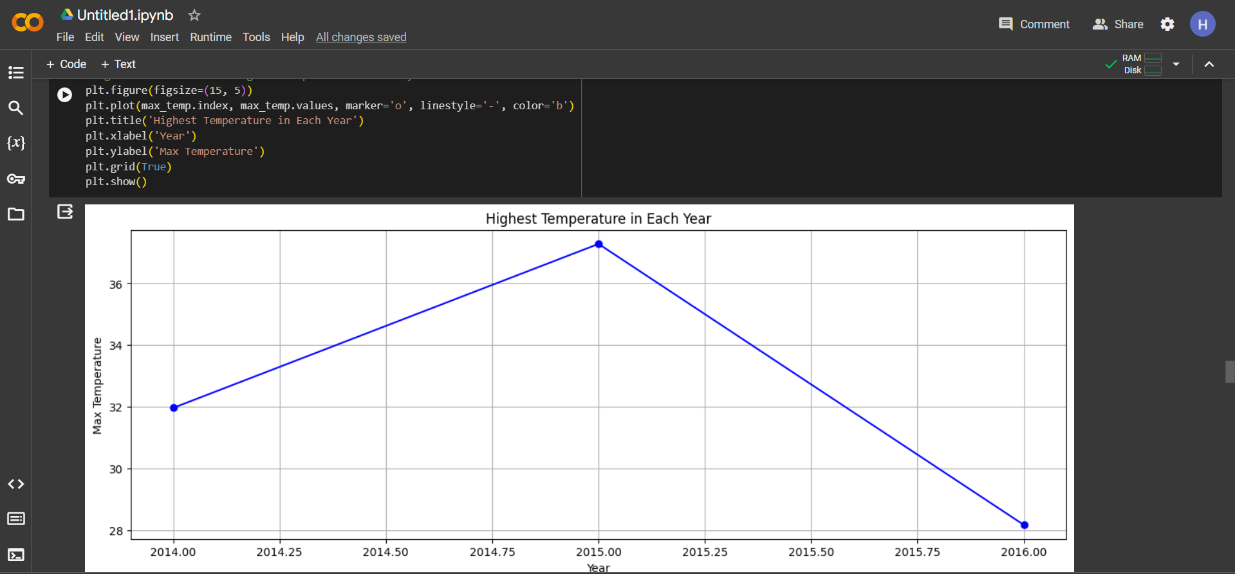
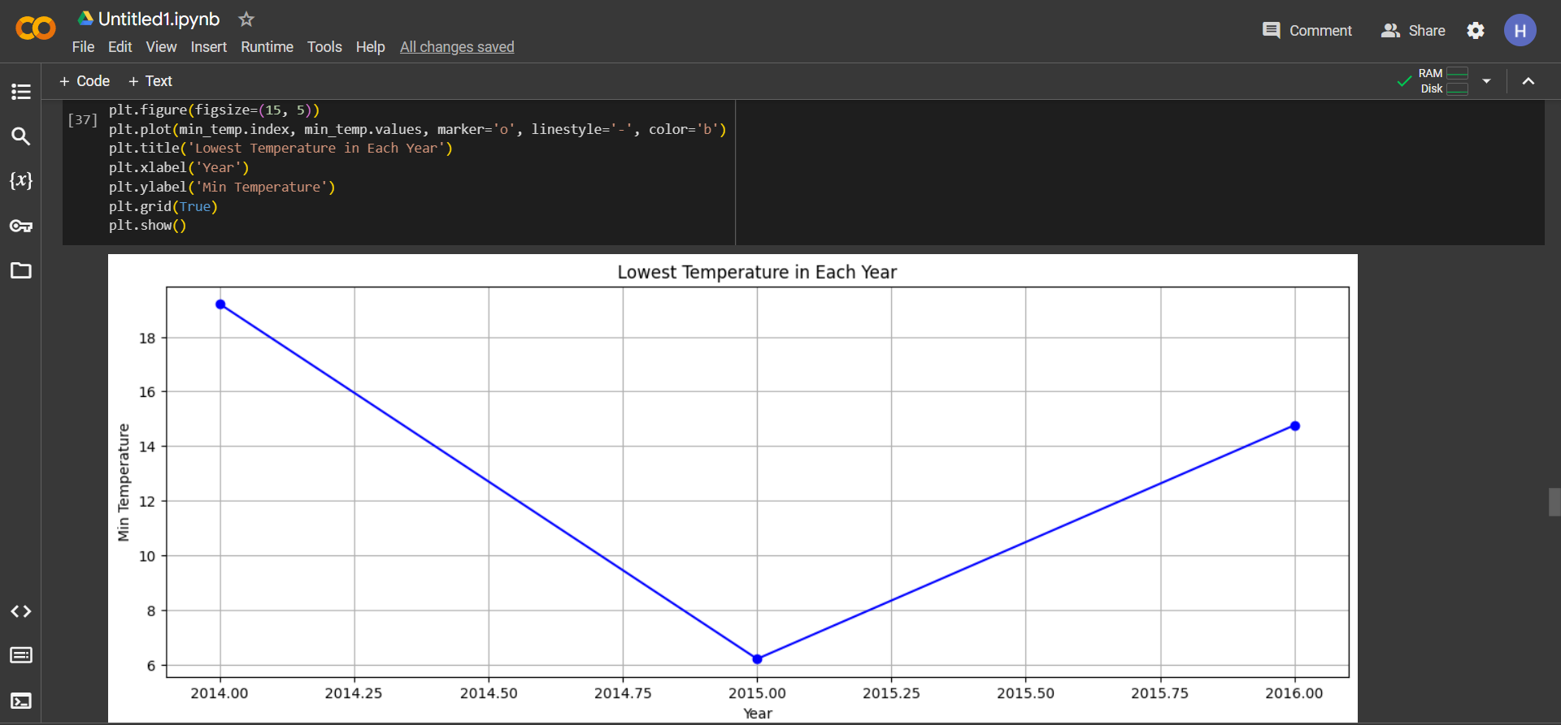
Plotting the highest and lowest temperatures over the years This visualization allows for observing temperature fluctuations annually, offering insights into changes over time.

Slide 16
Steps and processes including in the project
3.4 Feature selection
The code selects relevant features, focusing on highly correlated variables that contribute significantly to temperature predictions. This step streamlines the dataset to focus on the most key factors for forecasting.

Slide 17
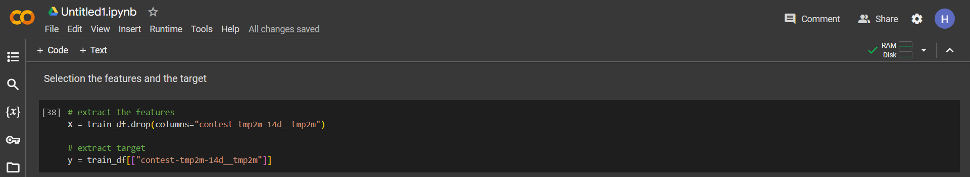
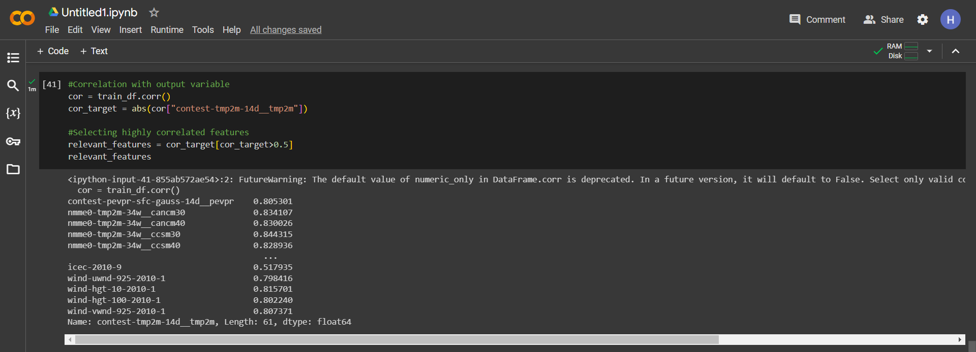
Steps and processes including in the project
The code begins by computing the correlation between each feature and the target variable (temperature prediction). It quantifies the strength and direction of linear relationships between variables. Using the correlation analysis results, the code selects highly correlated features that exhibit a strong relationship with the target temperature variable. This step focuses on features that demonstrate a correlation above a certain threshold (e.g., 0.5), indicating their significant influence on temperature predictions.

Slide 18
Steps and processes including in the project
3.5 Splitting the dataset
In the code, splitting the dataset is a critical step in preparing the data for model training and evaluation

Slide 19
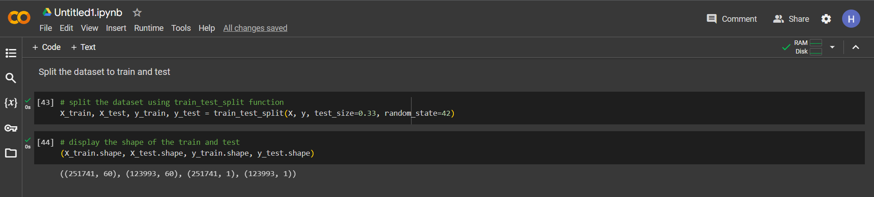
Steps and processes including in the project
The dataset is divided into two subsets: a training set and a testing set. The train_test_split function from the sklearn.model_selection module is used for this purpose. Typically, a common split ratio (70% training data and 30% testing data) is applied.

Slide 20
Steps and processes including in the project
3.6 Model Building
The project involves building machine learning models for temperature prediction. It utilizes various algorithms such as CatBoost, Gradient Boosting. The models are trained on the selected features to learn patterns and relationships

Slide 21
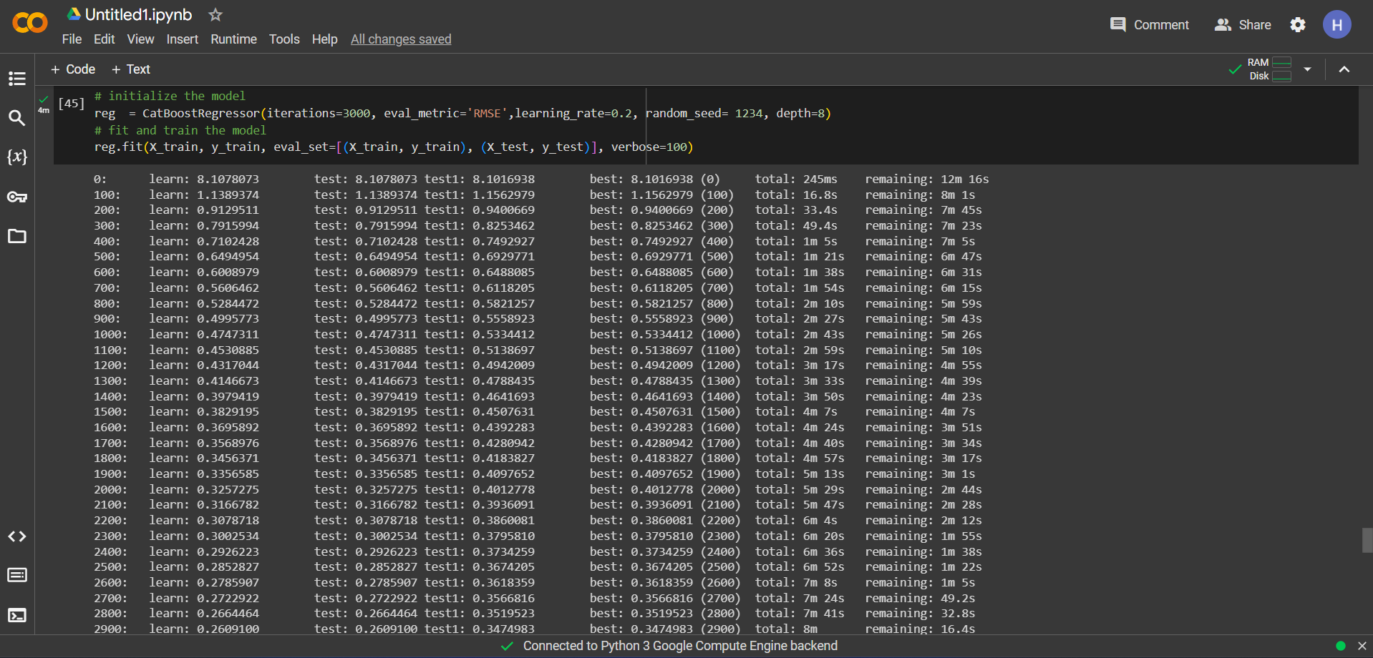
Steps and processes including in the project
CatBoostRegressor:
The model enhancing decision to predict target values with high accuracy.

Slide 22
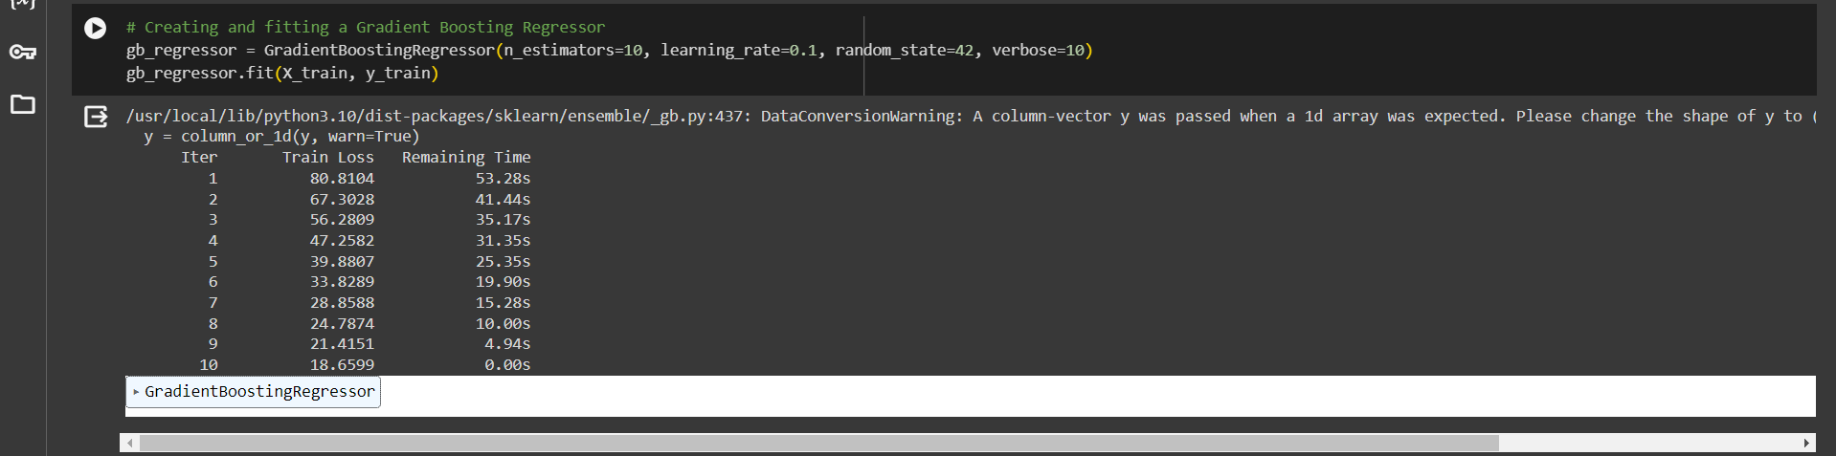
Steps and processes including in the project
GradientBoostingRegressor:

Slide 23
Steps and processes including in the project
3.7 Model prediction
The trained models are used to make predictions on test datasets, generating forecasts for sub-seasonal temperatures.

Slide 24
Steps and processes including in the project
CatBoostRegressor:

Slide 25
Steps and processes including in the project
GradientBoostingRegressor:

Slide 26
Steps and processes including in the project
3.8 Model evaluation
After training, the models are evaluated using metrics like Root Mean Squared Error (RMSE) and Mean Squared Error (MSE). These metrics assess the models' predictive performance and how well they estimate temperature values.

Slide 27
Steps and processes including in the project
CatBoostRegressor:
In evaluating the models for temperature prediction, typically, the model with the lower Root Mean Squared Error (RMSE) or Mean Squared Error (MSE) is considered better as it signifies a smaller average difference between predicted and actual temperatures.

Slide 28
Steps and processes including in the project
GradientBoostingRegressor:
For instance, CatBoostRegressor yields an RMSE of 0.34, GradientBoostingRegressor produces 18.65 , so CatBoostRegressor, with the lowest RMSE, would be considered the better-performing model between the two for predicting temperatures in this context.

Slide 29

Conclusion:
This project implements machine learning models for sub-seasonal weather forecasting. It involves comprehensive data preprocessing, feature selection, and model training using CatBoost, Gradient Boosting,. Leveraging a wide meteorological features, the models aim to predict temperatures crucial for understanding long-term weather patterns. The evaluation of these models using Root Mean Squared Error (RMSE) and Mean Squared Error (MSE) provides insights into their predictive performance.

